Slide 1
NLP

Slide 2
Introduction to NLP
Training Neural Networks
Backpropagation

Slide 3
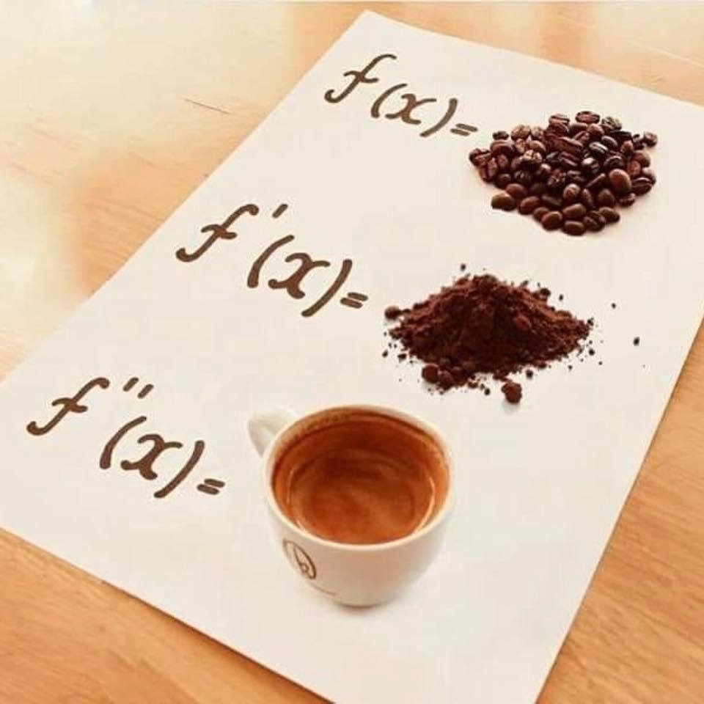

Slide 4
Quick Math Review
This equation
3
x
2
y
5
z
7
3
x
2
y
5
z
can be written as a dot product of two vectors:
x
7
3
2
5
y
z

Slide 5


Linear Algebra
Likewise, these equations
3
x
2
y
5
z
7
-1
x
3
y
9
z
12
4
x
$$\frac{1}{2}$$
y
0
z
8
can be written as a dot product of a matrix and a vector:
3
2
5
x
7
-1
3
9
y
12
4
$$\frac{1}{2}$$
0
z
8

Slide 6
Supervised Machine Learning
Parameters
(things we're learning)
w
Input feature vector
x
Sigmoid or other nonlinearity
σ
ŷ
Predicted
value

Slide 7
Supervised Machine Learning
w
x
Update parameters
σ
How wrong were we?
cost( , )
ŷ
y
Actual
value

Slide 8
A Simplified Diagram
x
w
σ
y

Slide 9
Training Process
Computational Graphs
Specify network structure
Describe the loss function
Provide training data
Set hyperparameters
Training/Backpropagation
For each epoch
For each batch (size 1-100)
Compute loss
Autograd: compute gradients
Prediction/Forward Propagation
(Decoding)

Slide 10
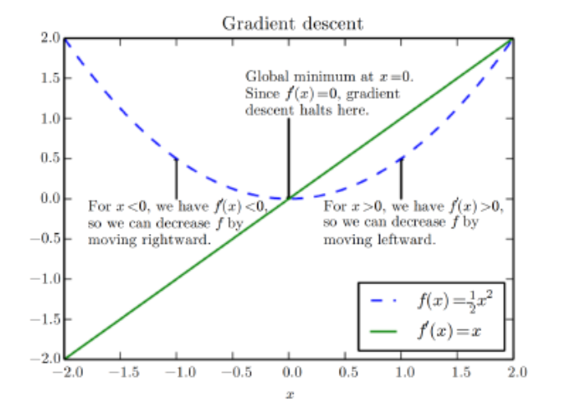
Gradient Descent
[Deep Learning book]

Slide 11
Gradient Descent Example
Starting value
w = (1,-1,-2,3)
accuracy 66%
Next value
w = (2,-2,-1,2)
accuracy 73%
Next value
w = (3,-2,-1,4)
accuracy 80%
etc.

Slide 12
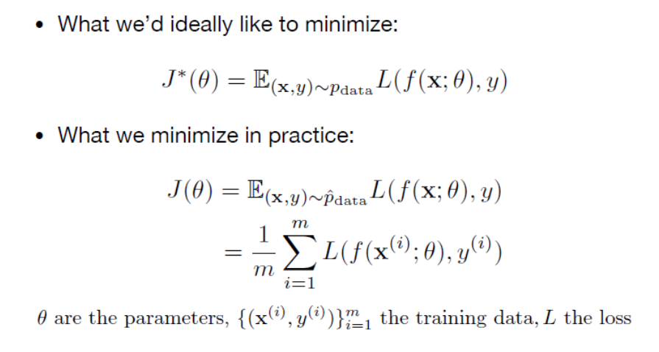
Empirical Risk Minimization (ERM)
[Example from Stephen Clark]

Slide 13
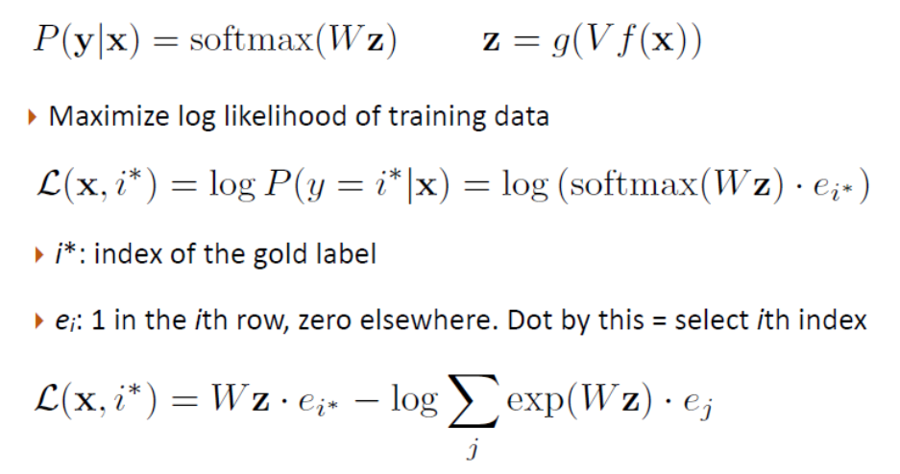
Training Process
[Greg Durrett]

Slide 14
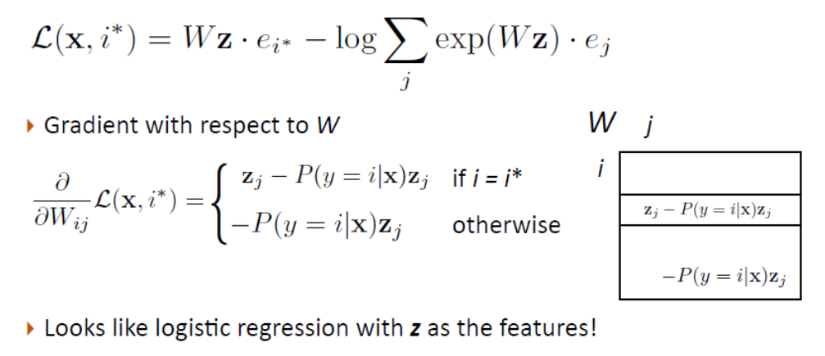
Computing Gradients
[Greg Durrett]

Slide 15
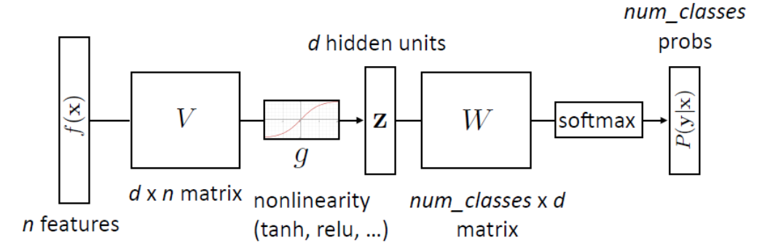
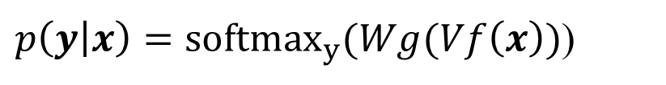

Example
Without a hidden layer
With a hidden layer
$$p\left(y | x\right)={softmax}_{y}(Wf\left(x\right))$$
$p\left(y | x\right)={softmax}_{y}(Wg(Vf\left(x\right))$)
[Greg Durrett]

Slide 16
Gradient Descent vs. Backpropagation
Backpropagation is an efficient way to compute gradients in a computational graph
It is based on the chain rule for derivatives/gradients

Slide 17
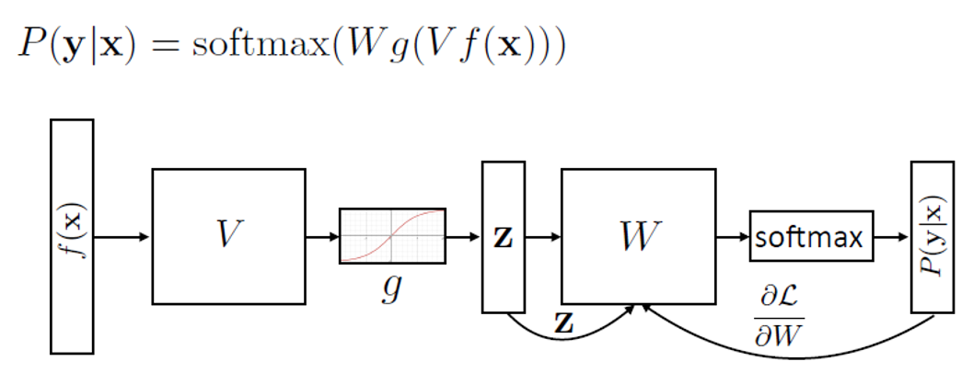
Classification Example
[Greg Durrett]

Slide 18
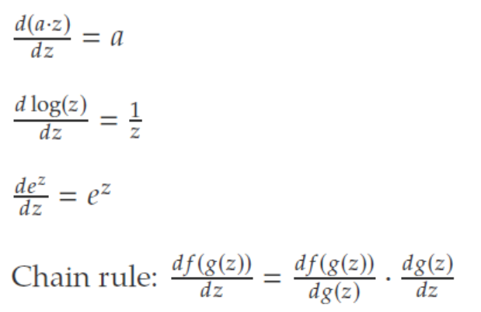
Useful Derivatives (1)

Slide 19
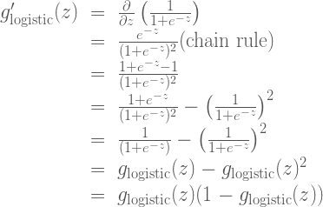
Useful Derivatives (2)
Two negatives cancel out
https://theclevermachine.wordpress.com/2014/09/08/derivation-derivatives-for-common-neural-network-activation-functions/

Slide 20

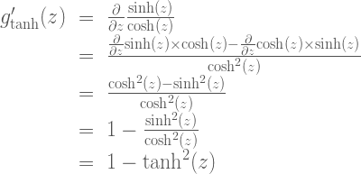
Useful Derivatives (3)
https://theclevermachine.wordpress.com/2014/09/08/derivation-derivatives-for-common-neural-network-activation-functions/

Slide 21
Computational Graphs
[Example from Vivek Srikumar]

Slide 23
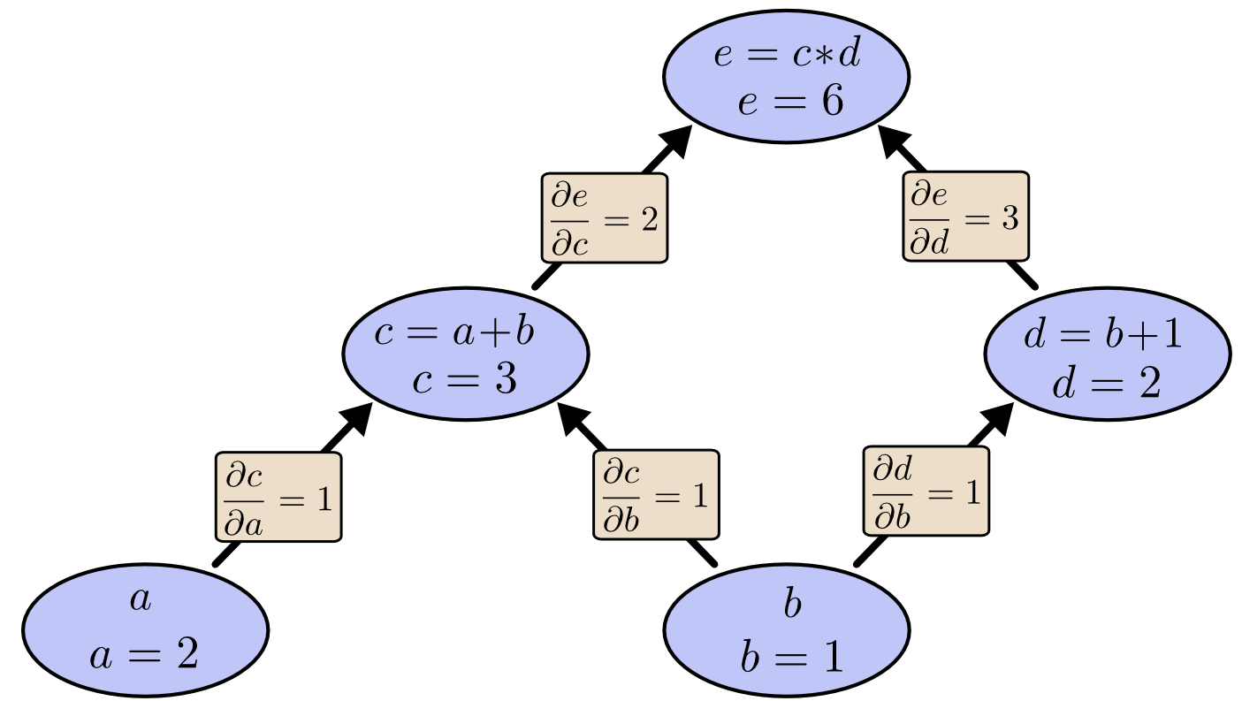
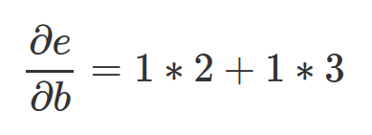
Example
[Chris Olah]

Slide 36
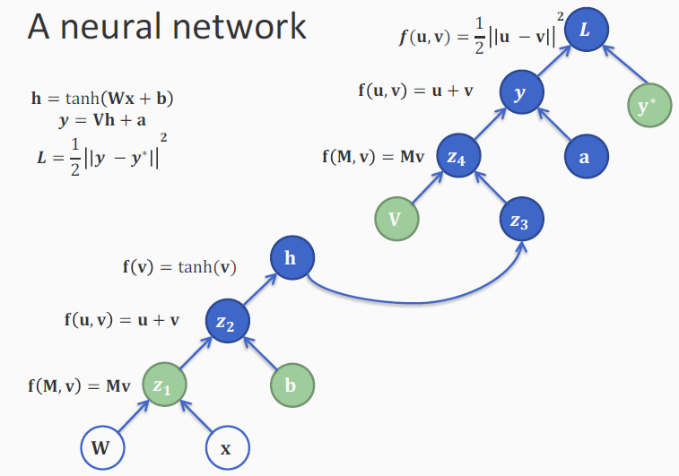

Slide 38
# Back-Propagation Neural Networks
# Placed in the public domain.
# Neil Schemenauer <nas@arctrix.com>
import math
import random
import string
random.seed(0)
# calculate a random number where: a <= rand < b
def rand(a, b):
return (b-a)*random.random() + a
# Make a matrix (we could use NumPy to speed this up)
def makeMatrix(I, J, fill=0.0):
m = []
for i in range(I):
m.append([fill]*J)
return m
# our tanh function, tanh is a little nicer than the standard 1/(1+e^-x)
def tanh(x):
return math.tanh(x)
# derivative of our tanh function, in terms of the output (i.e. y)
def dtanh(y):
return 1.0 - y**2

Slide 39
class NN:
def __init__(self, ni, nh, no):
# number of input, hidden, and output nodes
self.ni = ni + 1 # +1 for bias node
self.nh = nh
self.no = no
# activations for nodes
self.ai = [1.0]*self.ni
self.ah = [1.0]*self.nh
self.ao = [1.0]*self.no
# create weights
self.wi = makeMatrix(self.ni, self.nh)
self.wo = makeMatrix(self.nh, self.no)
# set them to random vaules
for i in range(self.ni):
for j in range(self.nh):
self.wi[i][j] = rand(-0.2, 0.2)
for j in range(self.nh):
for k in range(self.no):
self.wo[j][k] = rand(-2.0, 2.0)
# last change in weights for momentum
self.ci = makeMatrix(self.ni, self.nh)
self.co = makeMatrix(self.nh, self.no)

Slide 40
def update(self, inputs):
if len(inputs) != self.ni-1:
raise ValueError('wrong number of inputs')
# input activations
for i in range(self.ni-1):
#self.ai[i] = tanh(inputs[i])
self.ai[i] = inputs[i]
# hidden activations
for j in range(self.nh):
sum = 0.0
for i in range(self.ni):
sum = sum + self.ai[i] * self.wi[i][j]
self.ah[j] = tanh(sum)
# output activations
for k in range(self.no):
sum = 0.0
for j in range(self.nh):
sum = sum + self.ah[j] * self.wo[j][k]
self.ao[k] = tanh(sum)
return self.ao[:]

Slide 41
def backPropagate(self, targets, N, M):
if len(targets) != self.no:
raise ValueError('wrong number of target values')
# calculate error terms for output
output_deltas = [0.0] * self.no
for k in range(self.no):
error = targets[k]-self.ao[k]
output_deltas[k] = dtanh(self.ao[k]) * error
# calculate error terms for hidden
hidden_deltas = [0.0] * self.nh
for j in range(self.nh):
error = 0.0
for k in range(self.no):
error = error + output_deltas[k]*self.wo[j][k]
hidden_deltas[j] = dtanh(self.ah[j]) * error

Slide 42
# update output weights
for j in range(self.nh):
for k in range(self.no):
change = output_deltas[k]*self.ah[j]
self.wo[j][k] = self.wo[j][k] + N*change + M*self.co[j][k]
self.co[j][k] = change
#print N*change, M*self.co[j][k]
# update input weights
for i in range(self.ni):
for j in range(self.nh):
change = hidden_deltas[j]*self.ai[i]
self.wi[i][j] = self.wi[i][j] + N*change + M*self.ci[i][j]
self.ci[i][j] = change
# calculate error
error = 0.0
for k in range(len(targets)):
error = error + 0.5*(targets[k]-self.ao[k])**2
return error

Slide 43
def test(self, patterns):
for p in patterns:
print(p[0], '->', self.update(p[0]))
def weights(self):
print('Input weights:')
for i in range(self.ni):
print(self.wi[i])
print()
print('Output weights:')
for j in range(self.nh):
print(self.wo[j])
def train(self, patterns, iterations=1000, N=0.5, M=0.1):
# N: learning rate
# M: momentum factor
for i in range(iterations):
error = 0.0
for p in patterns:
inputs = p[0]
targets = p[1]
self.update(inputs)
error = error + self.backPropagate(targets, N, M)
if i % 100 == 0:
print('error %-.5f' % error)

Slide 44
def demo():
# Teach network XOR function
pat = [
[[0,0], [0]],
[[0,1], [1]],
[[1,0], [1]],
[[1,1], [0]]
]
# create a network with two input, two hidden, and one output nodes
n = NN(2, 2, 1)
# train it with some patterns
print "Train"
n.train(pat)
# test it
print 'Input weights:'
for i in range(n.ni):
print n.wi[i]
print
print 'Output weights:'
for j in range(n.nh):
print n.wo[j]
print ''
print "Test"
n.test(pat)
if __name__ == '__main__':
demo()

Slide 45
Train
error 0.94250
error 0.04287
error 0.00348
error 0.00164
error 0.00106
error 0.00078
error 0.00063
error 0.00053
error 0.00044
error 0.00038
Input weights:
[3.3666124174428993, -1.1983458654063894]
[3.3456930315896676, -1.194806124059644]
[-1.6784196591864349, 1.104256244910066]
Output weights:
[2.851039122470194]
[3.3207045609331445]
Test
([0, 0], '->', [0.00424108155062589])
([0, 1], '->', [0.9821508029410748])
([1, 0], '->', [0.9820129388618121])
([1, 1], '->', [-0.0011469114721422528])

Slide 46
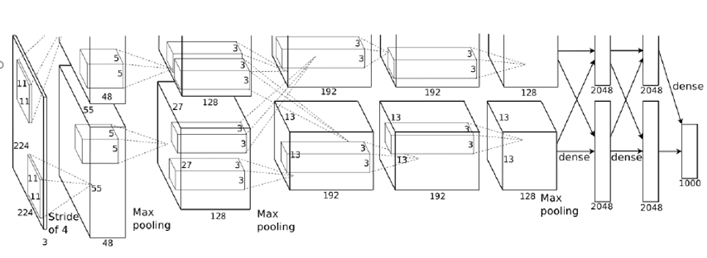
Realistic Neural Network
[AlexNet – Krizhevsky et al. 2011

Slide 47
Ideas
Dynamic Programming for keeping track of intermediate results
Regularization
Dropout

Slide 48


Stochastic Gradient Descent
Batch mode
Consider each data point for each update of w
This is slow
Stochastic mode
Update w after each data point
Logistic regression stochastic update (p is between 0 and 1)
Perceptron stochastic update (y is 0 or 1; approximation for LR)
$$w_{i}+α\left(y−\hat{p}\left(x\right)\right)x_{i}$$
$$w_{i}+α\left(y−\hat{y}\right)x_{i}$$

Slide 49
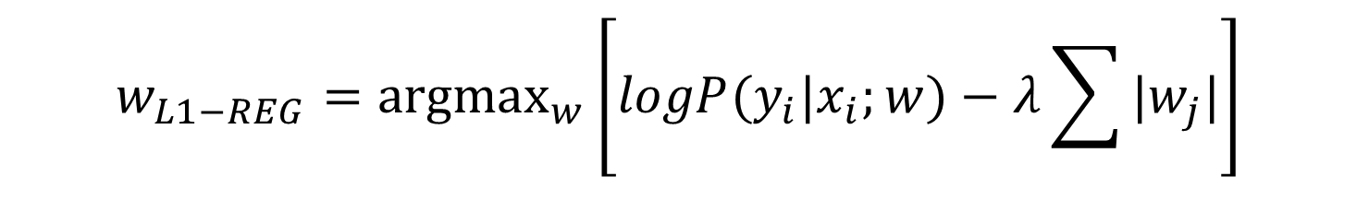
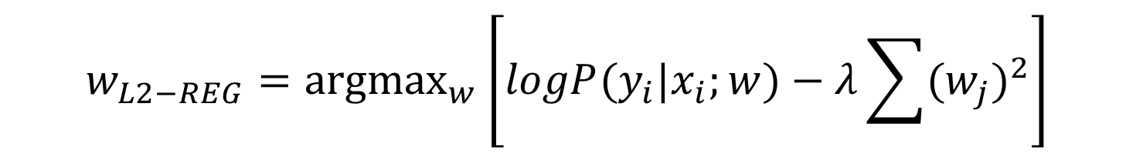
Regularization
Penalize large weights (we don’t want weights of 500,000)
L₂ regularizer
L₁ regularizer
$$w_{L2−REG}={\text{argmax}}_{w}{\left[logP(y_{i}|x_{i};w)−λ\sum{{(w_{j})}^{2}}\right]}_{ }$$
$$w_{L1−REG}={\text{argmax}}_{w}{\left[logP(y_{i}|x_{i};w)−λ\sum{|w_{j}|}\right]}_{ }$$

Slide 50
Other Notes
Dropout
Stochastically set some values to zero during training
A form of regularization
One line of code in pytorch
Optimization
Variants: e.g., adaptive/adagrad
Optional link:
https://towardsdatascience.com/types-of-optimization-algorithms-used-in-neural-networks-and-ways-to-optimize-gradient-95ae5d39529f

Slide 51
Links about Backpropagation
http://colah.github.io/posts/2015-08-Backprop/
https://medium.com/@karpathy/yes-you-should-understand-backprop-e2f06eab496b
https://machinelearningmastery.com/implement-backpropagation-algorithm-scratch-python/
http://staff.itee.uq.edu.au/janetw/cmc/chapters/BackProp/index2.html
https://medium.com/@14prakash/back-propagation-is-very-simple-who-made-it-complicated-97b794c97e5c
https://stats.stackexchange.com/questions/235528/backpropagation-with-softmax-cross-entropy
http://neuralnetworksanddeeplearning.com/chap2.html
https://google-developers.appspot.com/machine-learning/crash-course/backprop-scroll/
https://mattmazur.com/2015/03/17/a-step-by-step-backpropagation-example/

Slide 52
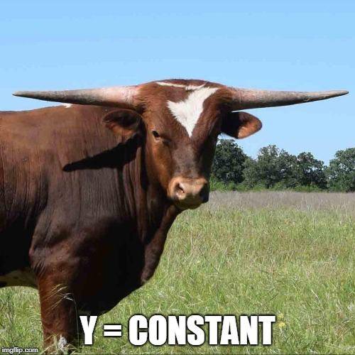
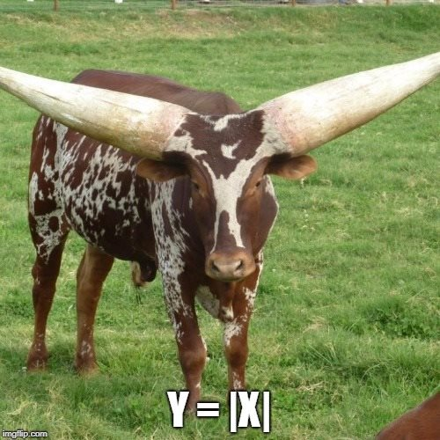
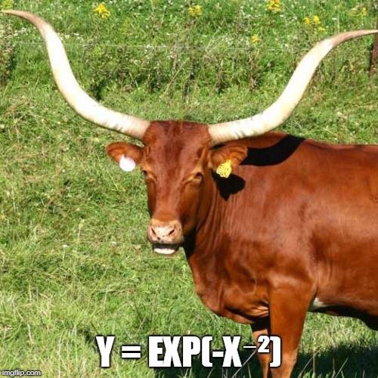
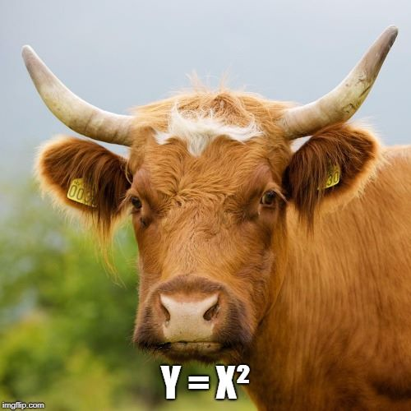
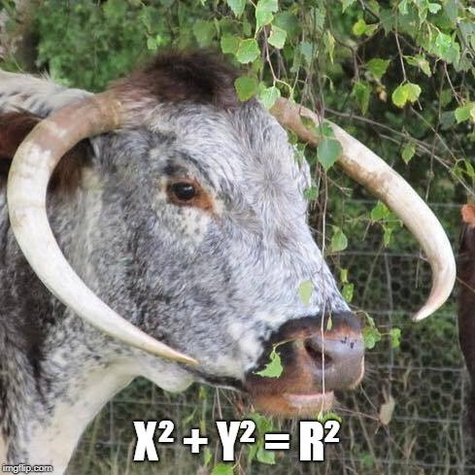
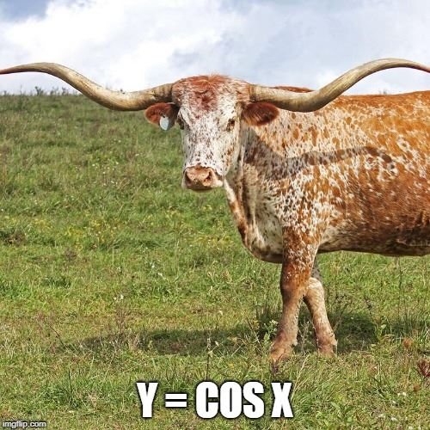
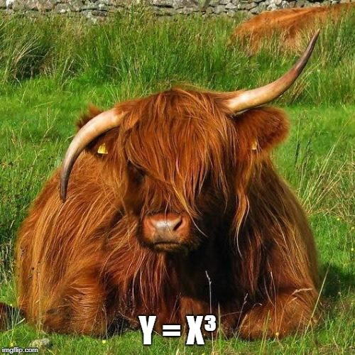
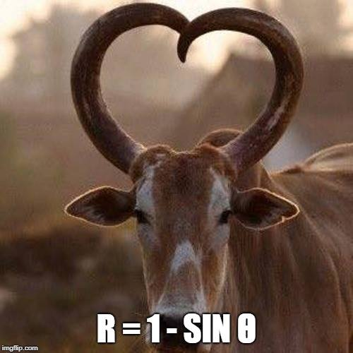

Slide 53
NLP

